Slide 1
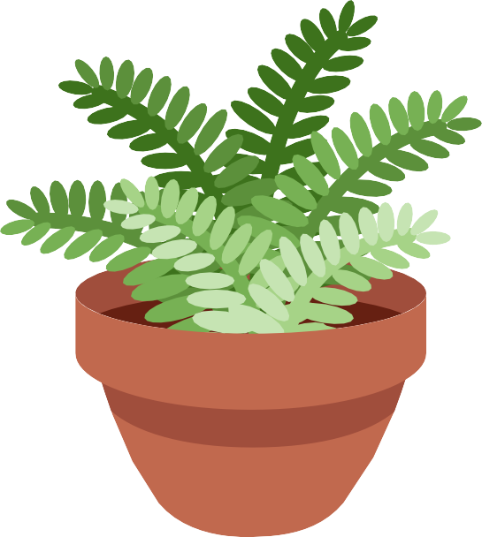
Aquabot
New York Institute of Technology
Let me water your plants

Slide 2




Group Introduction
Alexander Impastato
B.S. Electrical and Computer Engineering
Devin A. Job-Kassebaum
B.S. Biomedical Engineering
Sharjeel Owais
B.S. Electrical and Computer Engineering
Mandip Prajapati
B.S. Electrical and Computer Engineering

Slide 3




Agenda
Introduction Mission Background Block Diagram Flow Chart Components List
3D Representation Conclusion Resources
Questions

Slide 4
Introduction
What is Aquabot & What does it do?
Automated plant watering system
Helps to save money and reduce labor
Promotes indoor Greenary
Pre-defined path

Slide 5




Mission
Reduce Stress
Cut Down On SicTh Days Increases Productivity and Creativity (15%)
Save Money and Time
"To Plant a garden is to Believe in Tomorrow"

Slide 6
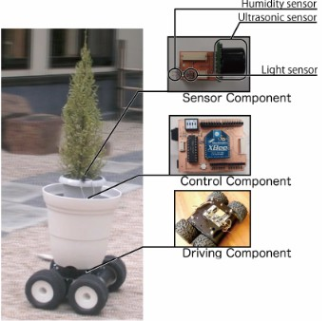
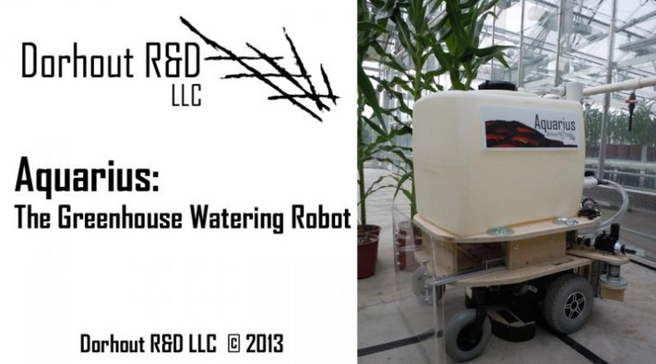
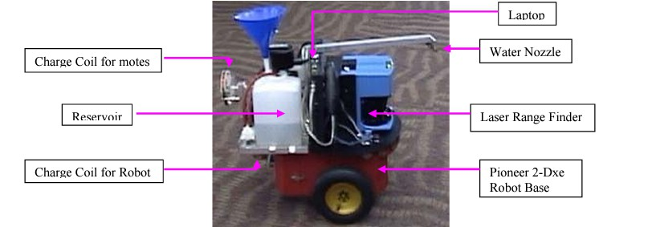
PotPet
Background
Robotic Plant Care System

Slide 7
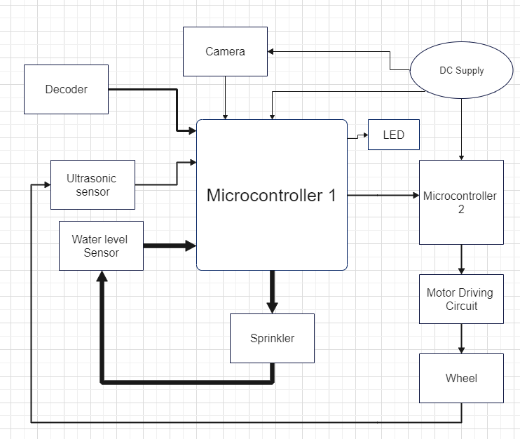



Block Diagram
Components
Microcontroller 1
Microcontroller 2 Camera
Ultrasonic Sensors
LED
Sprinkler
Motor Driving Circuit Wheels
DC power Supply

Slide 8
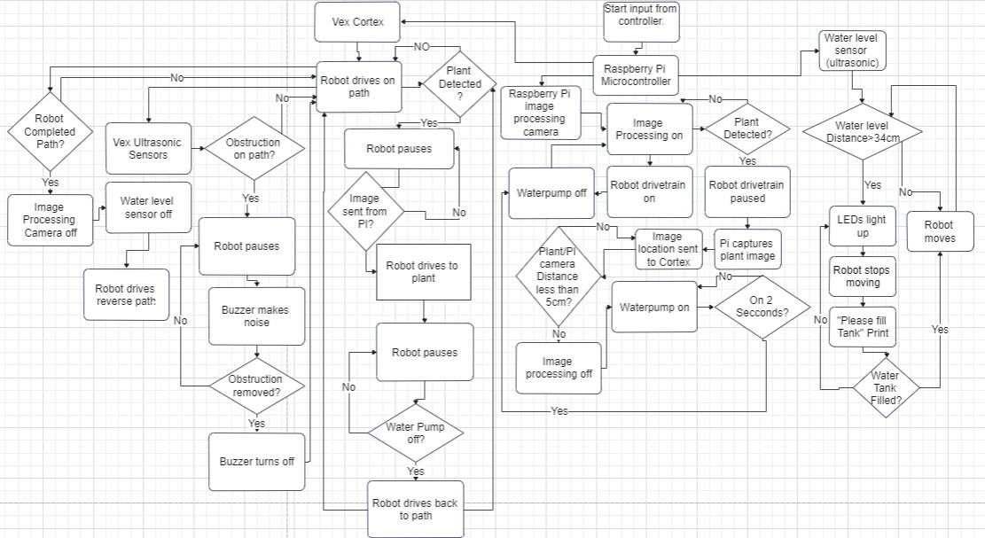
Flow Chart

Slide 9
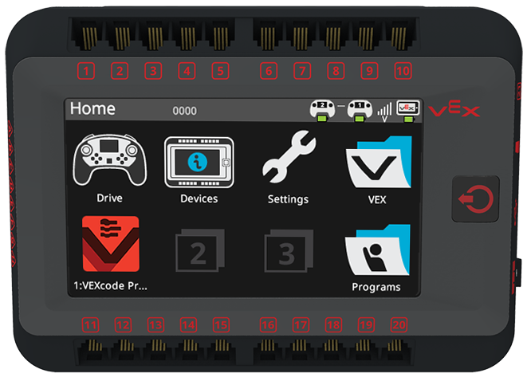
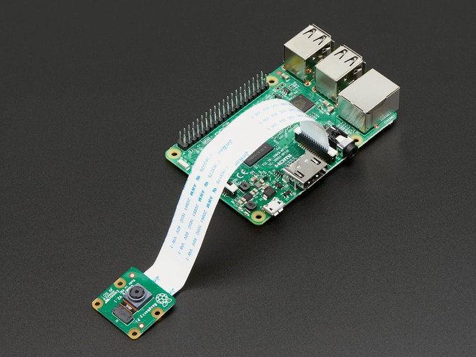
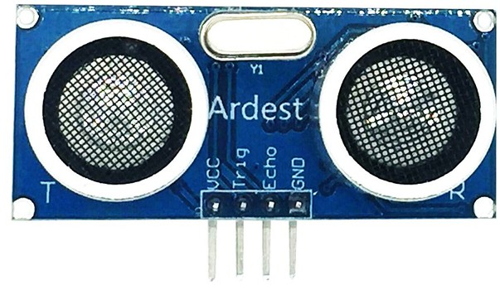
Flow Chart
Raspberry pi 4 and Pi camera
Vex cortex (V5 Robot Brain)
Ultrasonic Sensor

Slide 10
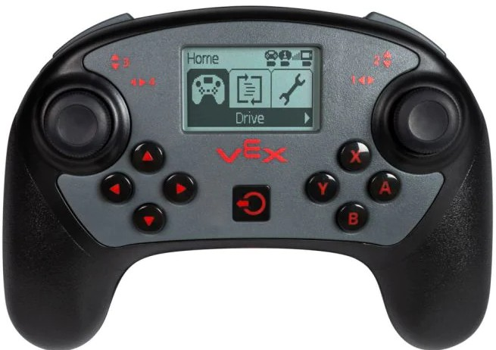
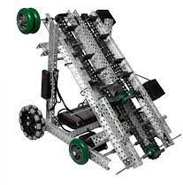
Flow Chart
V5 Controller
Vex Robot

Slide 11
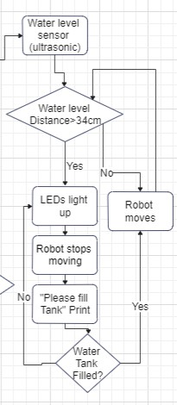
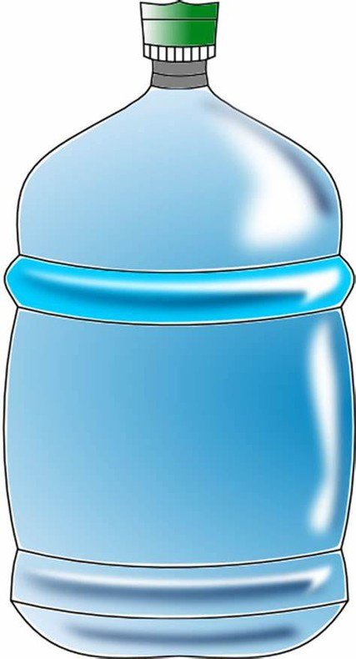
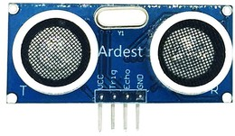
Flow Chart
Before leaving the starting point

Slide 12
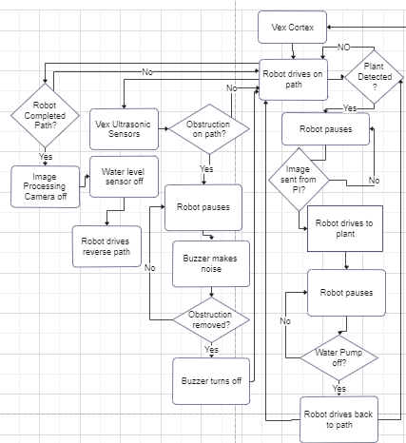
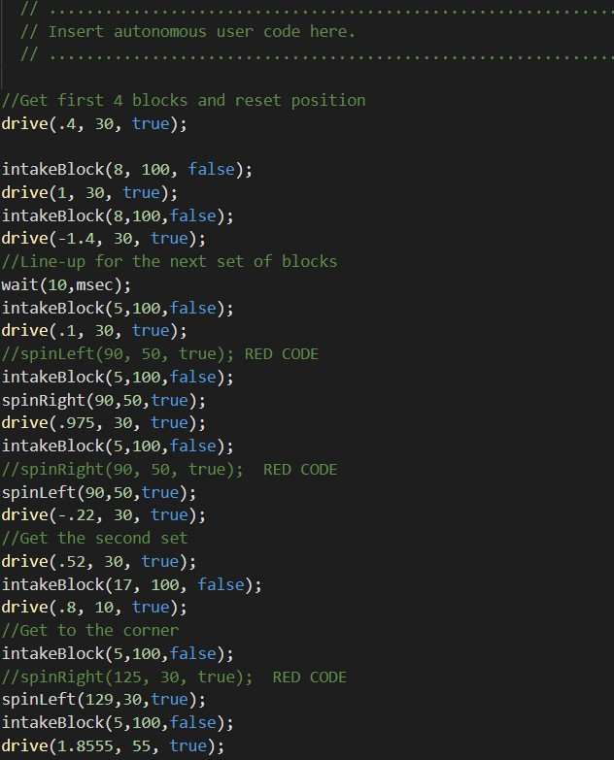
Flow Chart
Path of the robot

Slide 13
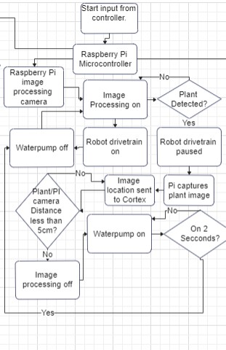
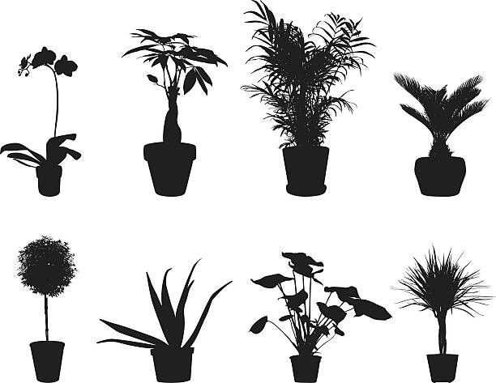
Flow Chart
Image Processing

Slide 14
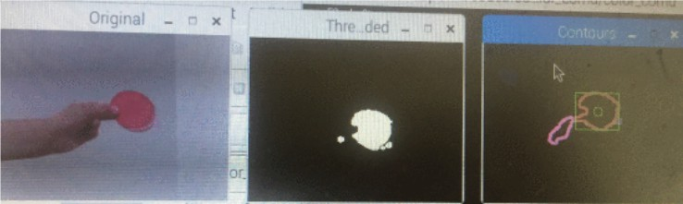
Flow Chart
Image Processing
Typical Steps in a color-based feature extraction algorithm are shown in the figure.
(a) Original image (b) Threaded image (c) Contours image ([4]) Enhancement of a VEX Robot with an Onboard Vision System.

Slide 15
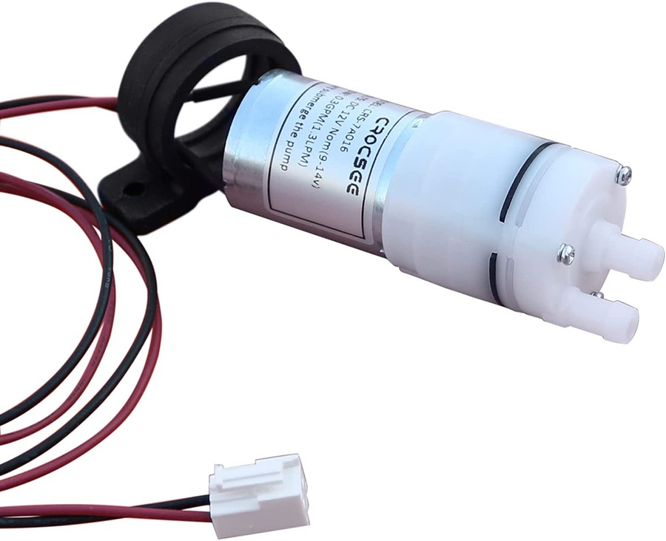
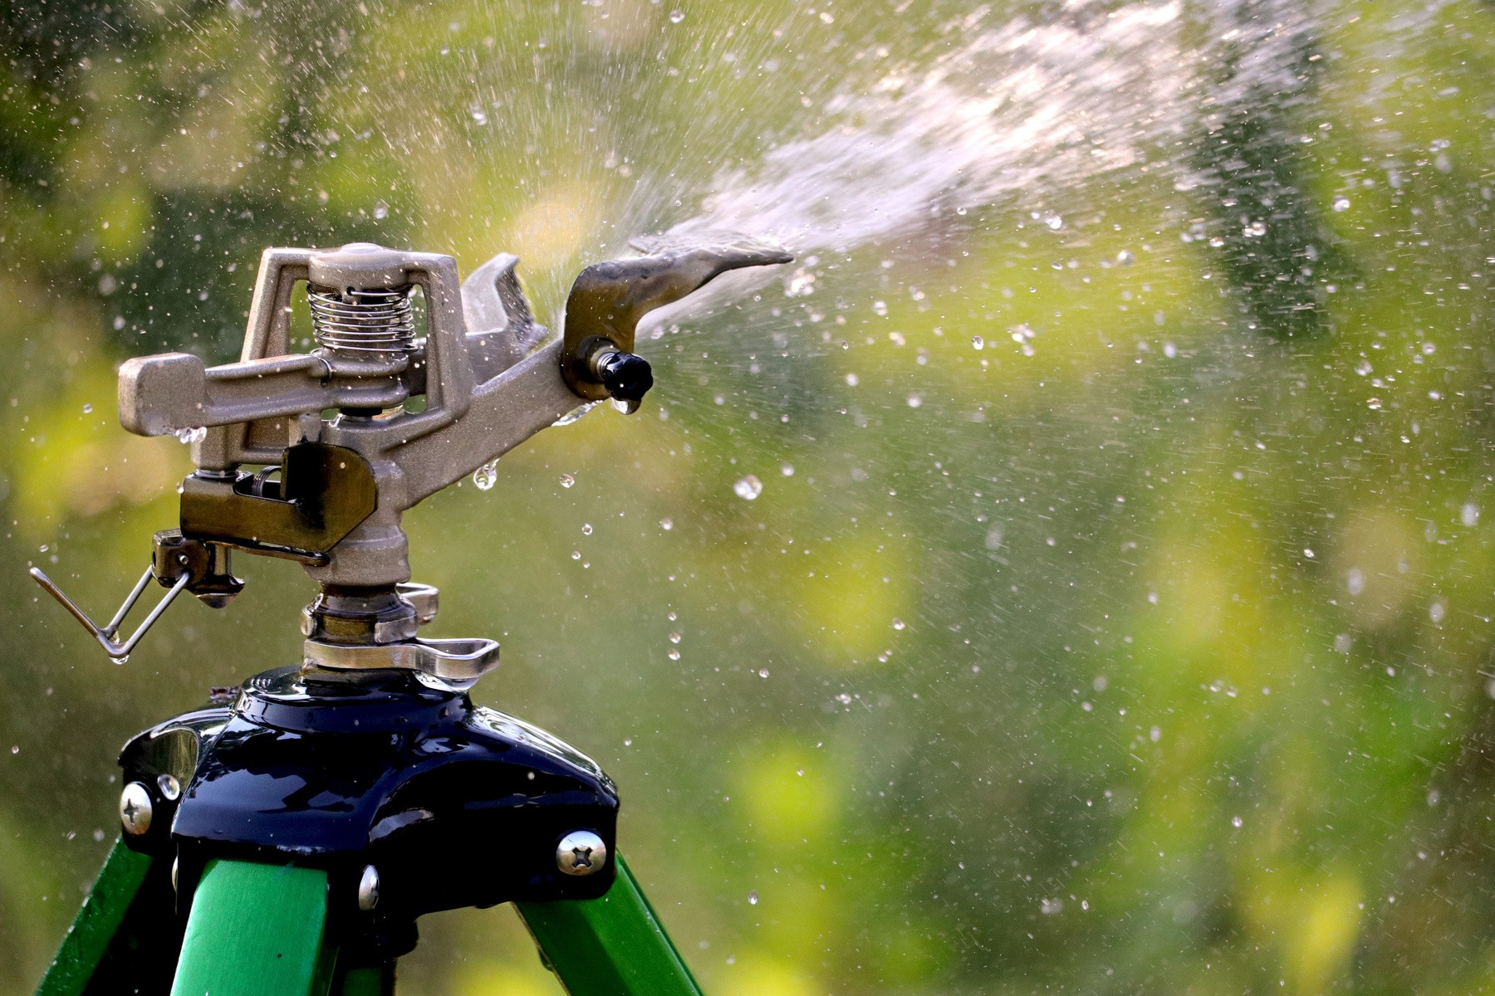
Flow Chart

Slide 16
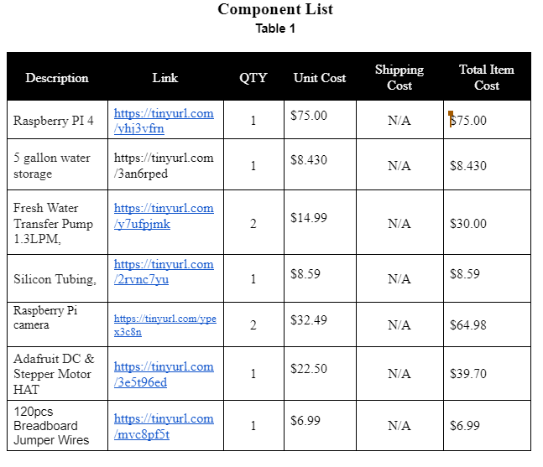
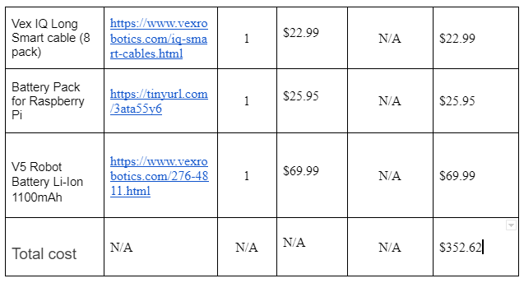
Component List

Slide 17
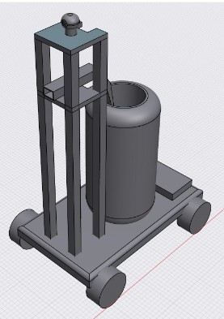


3D Representation of Aquabot
4 WTheels over tracTh pod Placement of Components SThaft
Camera Placement

Slide 18




Cost Effectiveness
2Thrs, 4x weeTh, $22/Thr
$176/montTh
$2,112/year
Robot Sells for $2,000

Slide 19
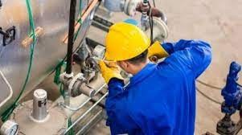
Maintenance Of Robot

Slide 20
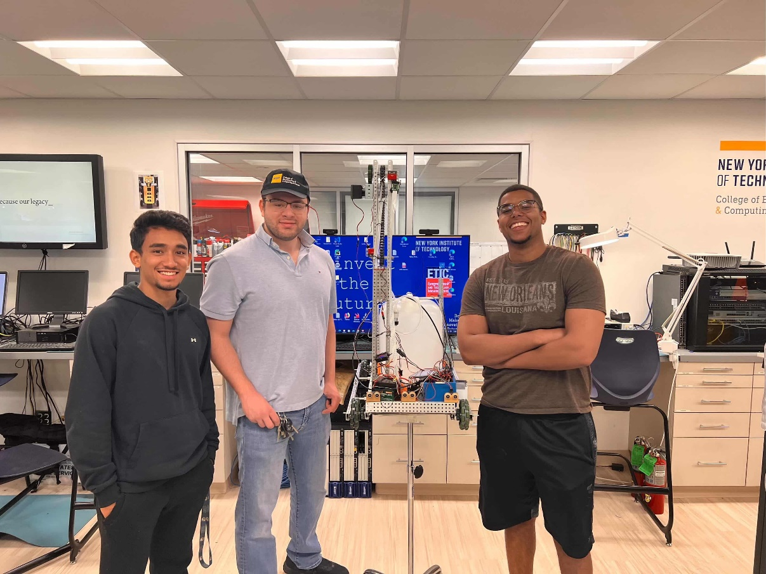
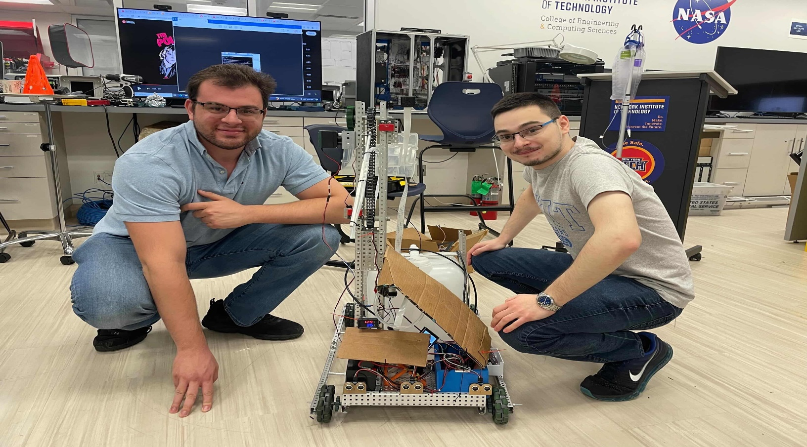
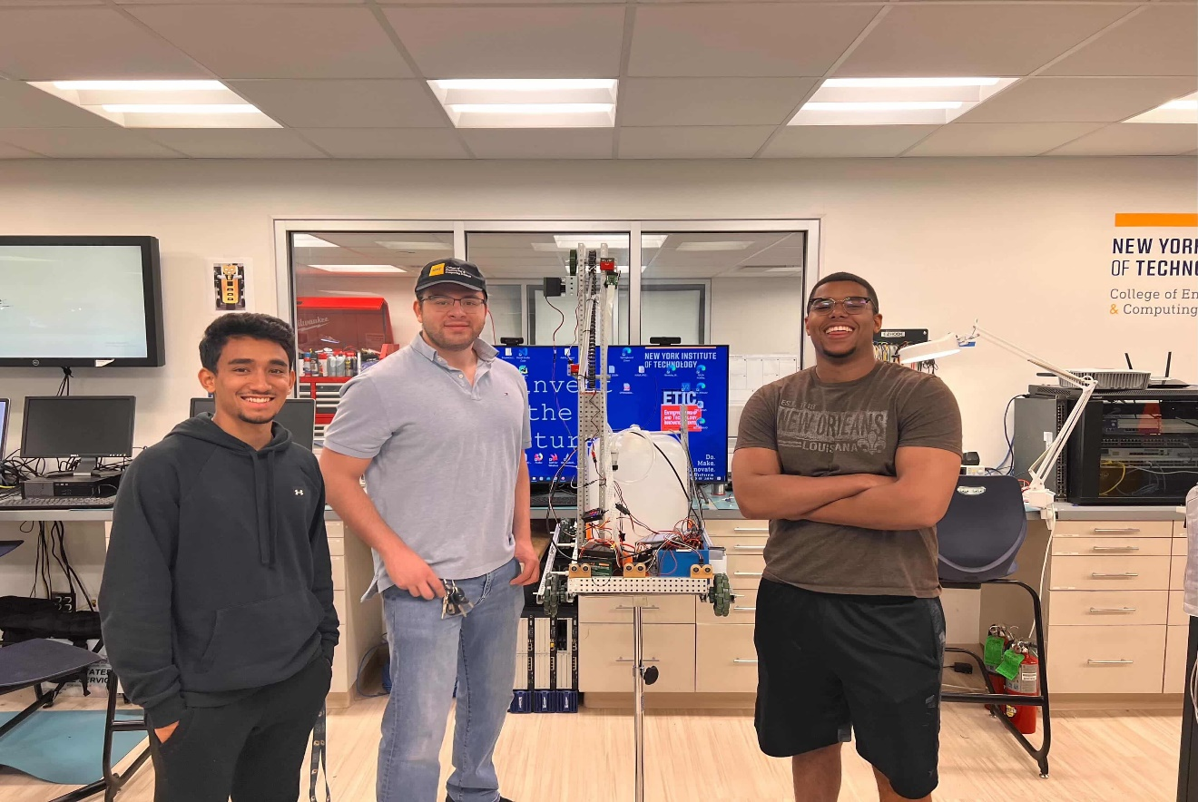
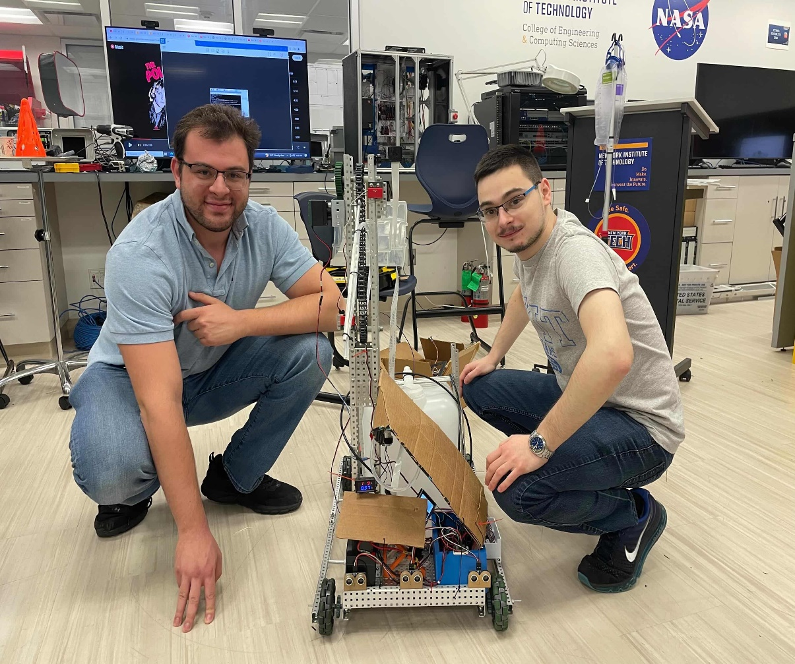
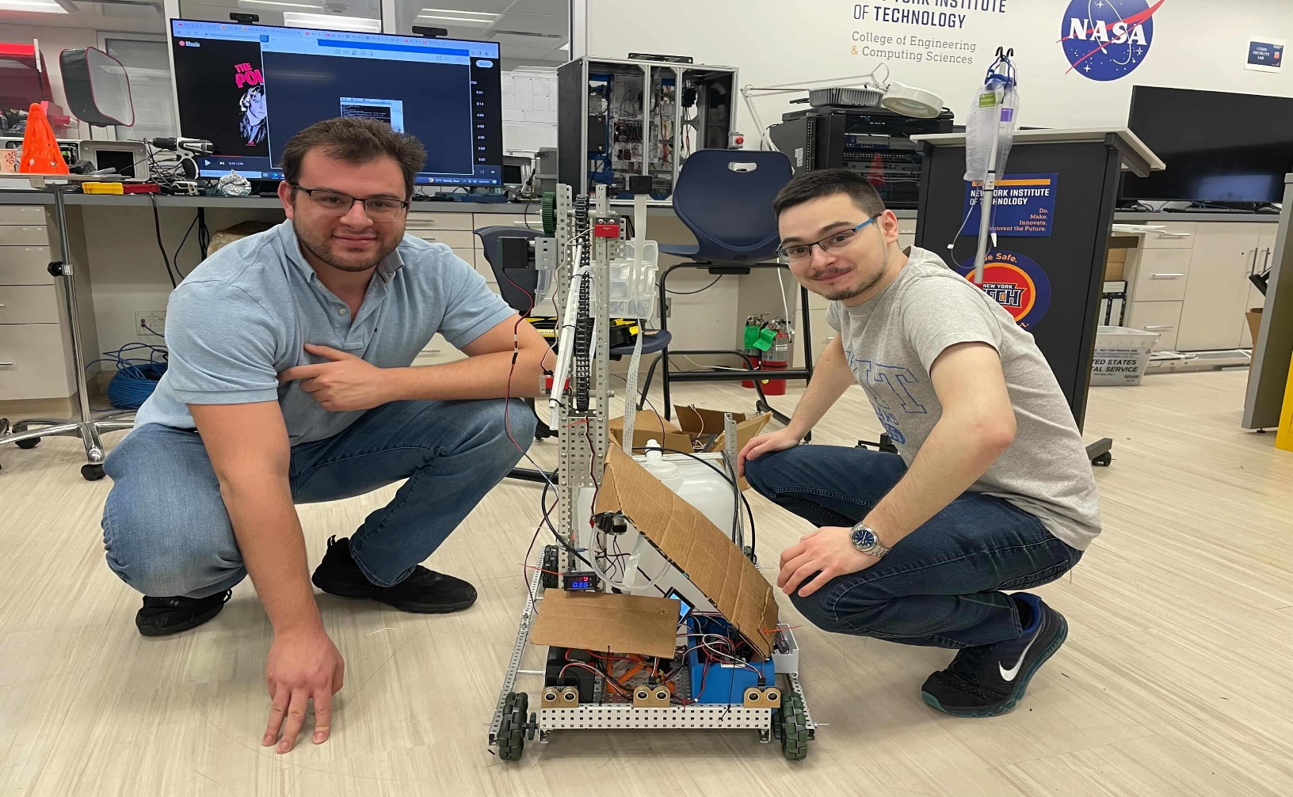
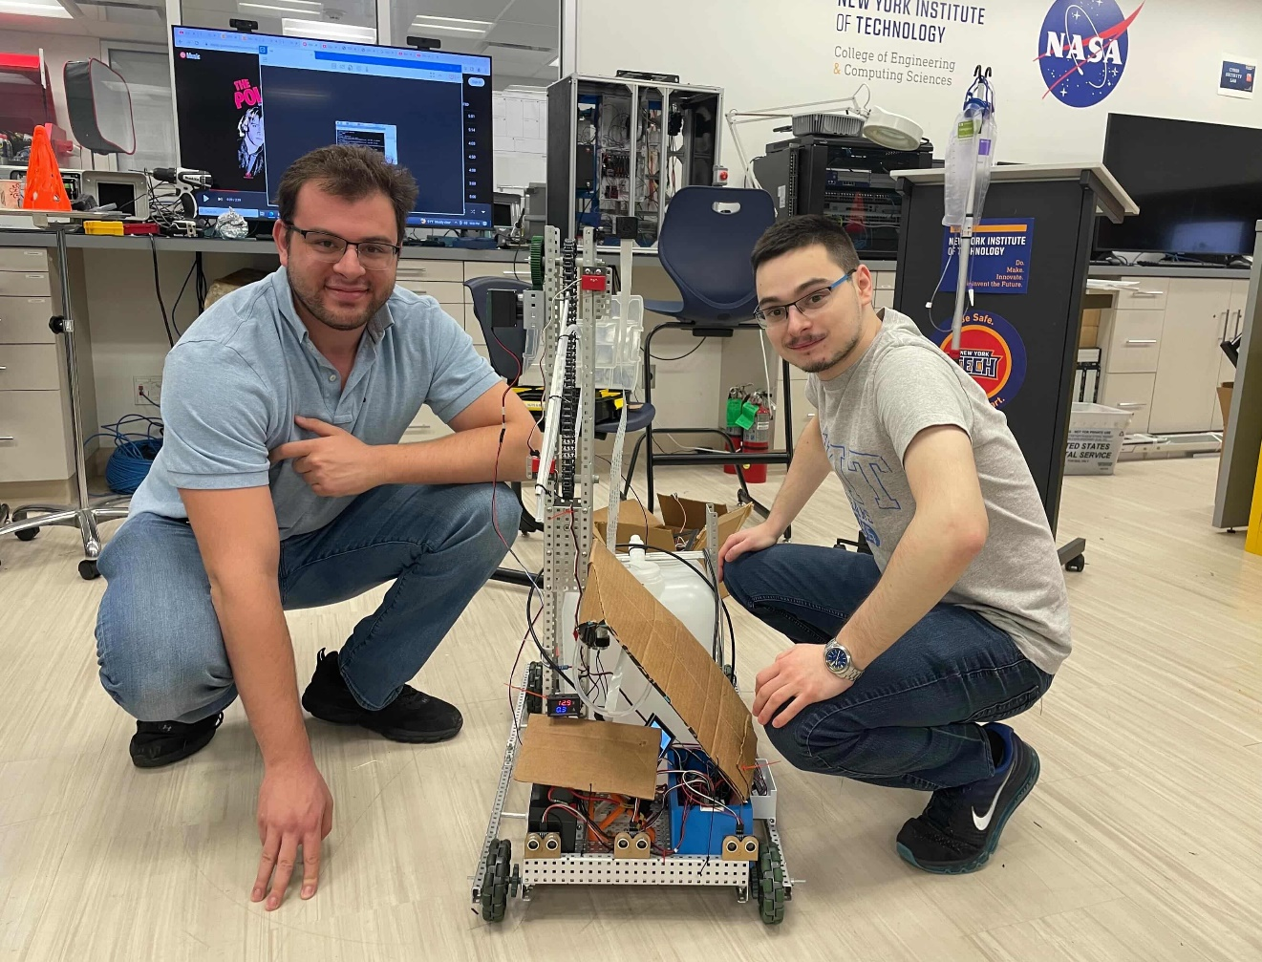
Physical Representation of Robot

Slide 21
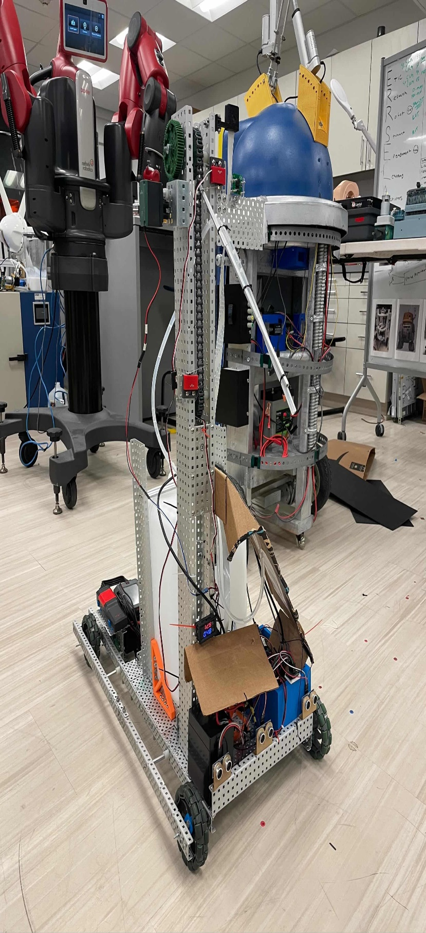
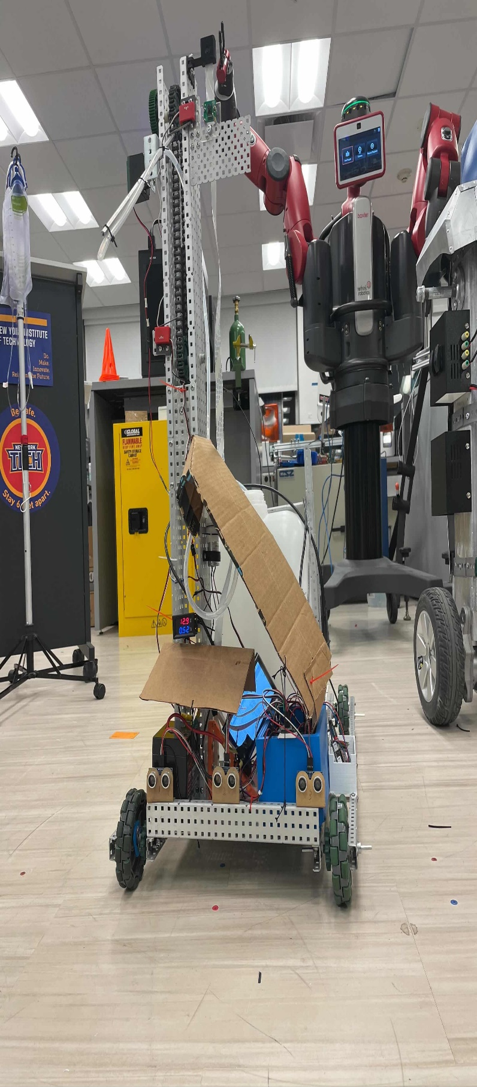
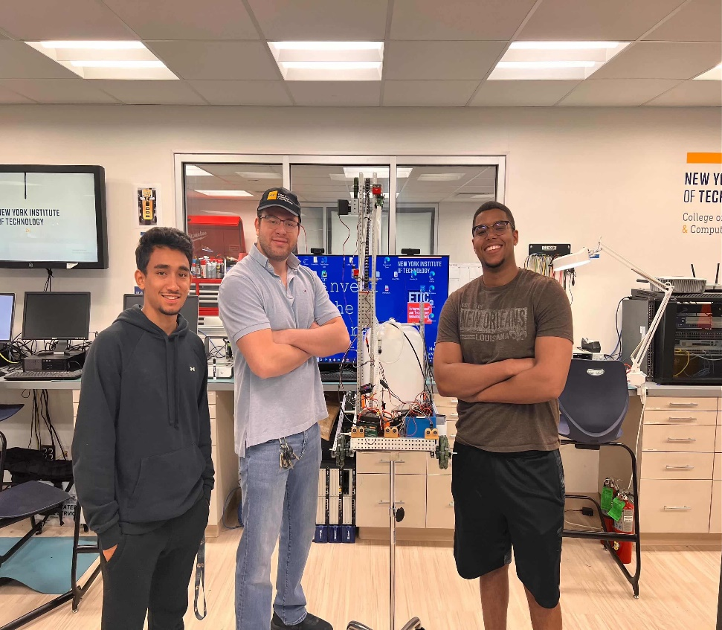
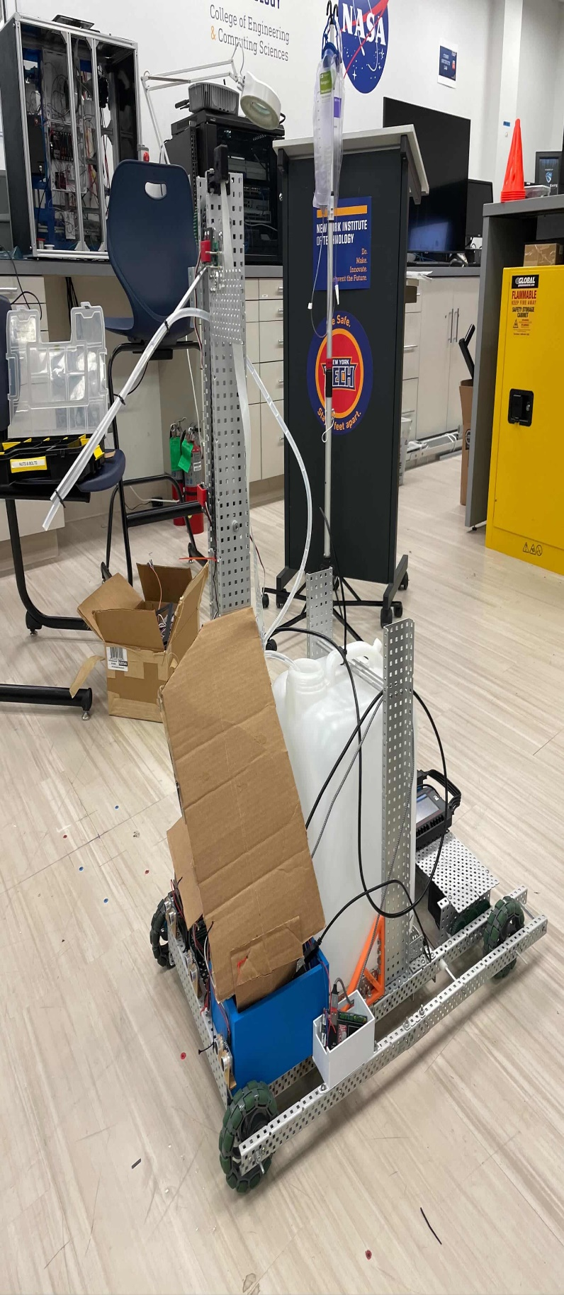

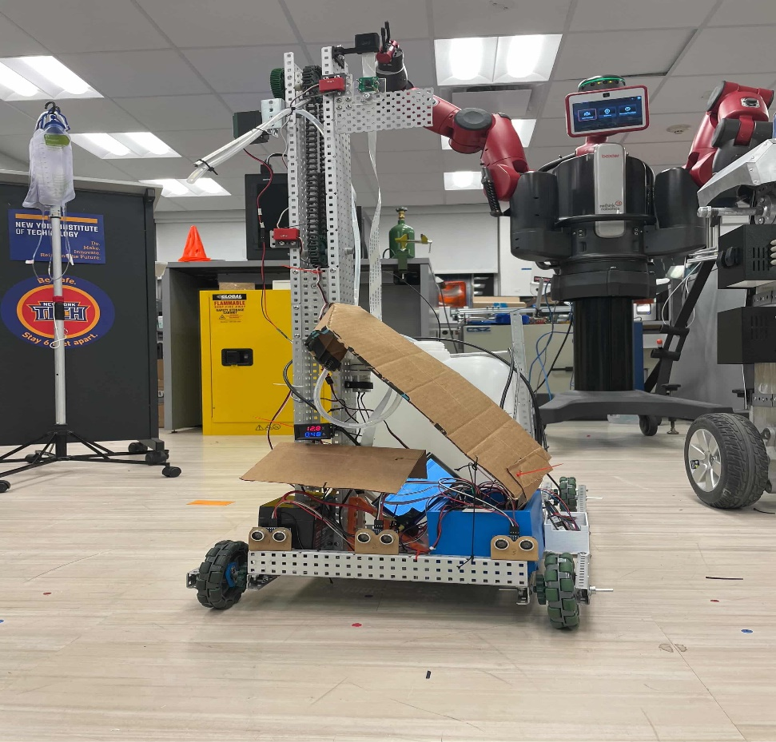
Physical Representation of Robot

Slide 22
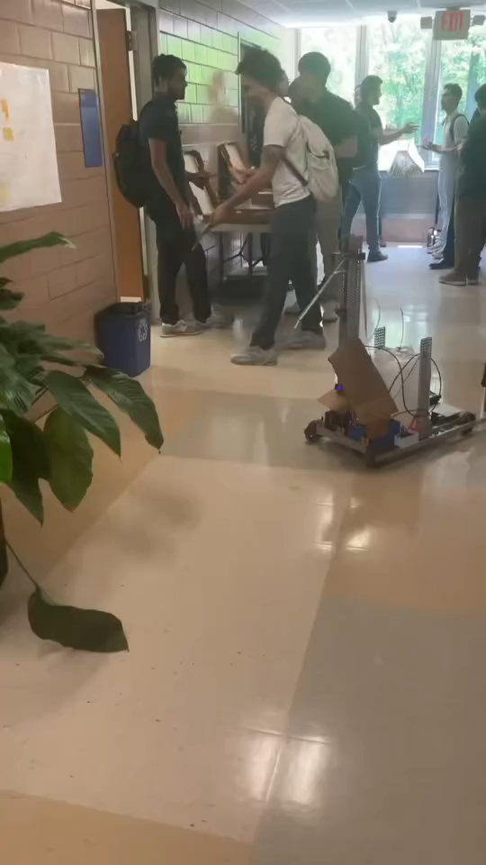
How Robot works

Slide 23
Resource Page
[1]SWNS, “Seven in 10 millennials consider themselves ‘plant parents,’” Medium, Feb. 04, 2020. https://swns-research.medium.com/seven-in-10-millennials-consider-themselves-plant-parents- 11ef0b34773c
“Aquarius: The Greenhouse Robot | LEARN.PARALLAX.COM,” learn.parallax.com. https://learn.parallax.com/educators/inspiration/aquarius-greenhouse-robot (accessed Nov. 20, 2022).
“Blooming and booming,” Garden Center Magazine. https://www.gardencentermag.com/article/blooming-and-booming-houseplant-report/
Nagaraja, Hema & Aswani, Reema & Malik, Monisha. (2012). Plant Watering Autonomous Mobile Robot. IAES International Journal of Robotics and Automation (IJRA). 1. 152-162. 10.11591/ijra.v1i3.1305.
Aswani, Reema & Nagaraja, Hema. (2013). RoboGardner: A Low-Cost System with Automatic Plant Identification Using Markers. 115. 309-324. 10.1007/978-3-642-37949-9_27.
Kumar, V. Sathiesh, et al. “Smart Autonomous Gardening Rover with Plant Recognition Using Neural Networks.” Procedia Computer Science, Elsevier, 12 Aug. 2016, https://www.sciencedirect.com/science/article/pii/S1877050916315356.
Wang, Junhua, et al. “Optimization Design of Wireless Charging System for Autonomous Robots Based on Magnetic Resonance Coupling.” AIP Publishing, AIP Publishing LLCAIP Publishing, 1 Jan. 1970, https://aip.scitation.org/doi/full/10.1063/1.5030445.

Slide 24
Resource Page
[8] Vucha, M. & Jyothi, K. & Kumari, K. & Karthik, Rajesh. (2019). Cost effective autonomous plant watering robot. International Journal of Recent Technology and Engineering. 7. 67-69.
[9 ]Swu, Vikaho & Kharir, Ibaphyrnaishisha & Bora, Dibya. (2020). Identification of Different Plants through Image Processing Using Different Machine Learning Algorithms. 43. 172-179.
[10] Kawakami, Ayumi & Tsukada, Koji & Kambara, Keisuke & Siio, Itiro. (2011). PotPet: pet-like flowerpot robot. 263-264. 10.1145/1935701.1935755.
[11]A.O. Adeodu, O.P. Bodunde, I.A. Daniyan, O.O. Omitola, J.O. Akinyoola, U.C. Adie, Development of an autonomous mobile plant irrigation robot for semi-structured environment, Procedia Manufacturing, Volume 35, 2019,
Pages 9-15, ISSN 2351-9789, https://doi.org/10.1016/j.promfg.2019.05.004.(https://www.sciencedirect.com/science/article/pii/S2351978919306389)
[12]K. Sikorski, “A Robotic Plant Care System”, A Thesis, University of Washington, Intel Research, 2003.
[13] L. Ma and M. Alborati, "Wireless Inter-Vehicle Communication Among VEX Robots," 2019 IEEE 11th International Conference on Engineering Education (ICEED), 2019, pp. 78-83, doi: 10.1109/ICEED47294.2019.8994949.
[14]L. Ma and M. Alborati, "Enhancement of a VEX Robot with an Onboard Vision System," 2018 IEEE 10th International Conference on Engineering Education (ICEED), 2018, pp. 117-121, doi: 10.1109/ICEED.2018.8626918.
[15] S. N. Ishak, N. N. N. A. Malik, N. M. A. Latiff, N. E. Ghazali and M. A. Baharudin, "Smart home garden irrigation system using Raspberry Pi," 2017 IEEE 13th Malaysia International Conference on Communications (MICC), 2017, pp. 101-106, doi: 10.1109/MICC.2017.8311741.

Slide 25




Do you have any questions?
Alexander Impastato
1-516-404-8830
aimpasta@nyit.edu
Feel free to reach out!
Devin Job-Kassebaum devinkassebaum@gmail.com djobkass@nyit.edu
Mandip Prajapati @ma_ndip mpraja01@nyit.edu
Sharjeel Owais Sharjeel2001@yahoo.com Sowais@nyit.edu

